Slide 1

1. Deepfake & Emerging AI Risk
“The convergence of GenAI, synthetic identities and real time digital identity verification. This will matter significantly because fraudsters will become AI-native, identity becomes the new battleground, fraud prevention will replace fraud detection, and the winners will use AI against AI.” – Director of Top 50 Global Insurance Firm

Slide 2
DEEPFAKE & EMERGING AI RISK
WHERE DEEPFAKE RISK CONCENTRATES
Banking and insurance converge on onboarding and payments, but diverge at the contact center
One-third of organizations globally¹ now report experiencing deepfake fraud incidents, on par with document fraud and social engineering. As organizations grapple with these risks, the emergence of agentic AI solutions (e.g., Meta Muse) introduces a new dimension of exposure, extending fraud concerns beyond impersonation to autonomous systems capable of performing / initiating activities on behalf of customers. Against this backdrop, the critical question is where AI-enabled fraud is exerting the greatest pressure today.
v
WHERE THEY CONVERGE
Digital onboarding, KYC & identity verification
Payments & claim flows
Both sectors feel pressure where identity is established and money moves
BANKING AND INSURANCE
BANKING
INSURANCE
70%
73%
64%
of all respondents cited as experiencing the greatest increase in vulnerability
flagged payment and transaction approvals
flagged claims and underwriting review
v
WHERE THEY DIVERGE
gap between insurance (72%) and banking (47%) respondents selecting the contact center as their most vulnerable channel
+25%
Contact center exposure
Insurance routes authentication, servicing and claims through the contact center whereas banking spreads that risk across digital channels
1 Deepfakes Already Hitting Businesses as Often as Traditional Fraud
For detailed data please refer to Appendix – B

Slide 3




DEEPFAKE & EMERGING AI RISK
Deepfake defense demands a coordinated response, not a single control
Asked which mitigation levers matter most, respondents spread their answers almost evenly: each of the four levers was selected by 43–53% of respondents. No single control stands out, which signals that leaders see deepfake defense as a combination of people, process, technology and intelligence.
FOUR LEVERS, EQUALLY WEIGHTED
BANKING & INSURANCE
Third-party intelligence
Prevention controls
Monitoring capabilities
Staff awareness & training
External data and consortium signals that reveal threats beyond one institution
Stopping synthetic identities and impersonation at the point of entry
Detecting anomalous behaviour and transactions in real time
Equipping frontline teams to recognize and challenge deepfakes
INSURANCE PRIORITY
“The biggest impact on risk management will be a shift toward continuous identity verification, real-time behavioural analytics, stronger cross-industry intelligence sharing, and AI-assisted investigations rather than relying primarily on point-in-time controls.”
THE OUTLIER: INSURERS LEAN ON THEIR STAFF
64%
of insurance respondents chose staff awareness & training, well above the 43–53% range seen for every other lever.
Why: With the contact centre as Insurers most exposed channel (72%), insurers rely heavily on frontline agents to authenticate callers and handle claims. Against voice-based deepfakes, staff awareness becomes a critical control.
– Fraud Strategy Executive, Top 100 Global Financial Institution
For detailed data please refer to Appendix – B

Slide 4
2. Information Sharing
“I really feel that fraud intelligence sharing can make a difference, but there are still practical barriers to doing it well” – SVP of Top 50 Global Insurance Firm

Slide 5





INFORMATION SHARING
ALIGNMENT ON THE PROBLEM
The top barriers to information sharing are structural and external
Respondents overwhelmingly point to ecosystem barriers rather than internal resistance. Data quality, legal constraints and participation gaps are the primary obstacles to scaling information sharing.
THE TOP THREE BARRIERS FORM A DEPENDENCY CHAIN % of respondents citing each barrier
# 1 · DATA STANDARDIZATION & POOR QUALITY
# 2 · LEGAL, PRIVACY & REGULATORY CONSTRAINTS
# 3 · LACK OF EXTERNAL INDUSTRY PARTICIPATION
77%
73%
60%
Shared intelligence is only as valuable as the data behind it. Without common definitions and consistent data quality, organizations lack a reliable basis for exchange.
Even with usable data, organizations need certainty about what they are allowed to share, with whom, and under what safeguards.
Once trusted data and clear guardrails in place can organizations have the confidence to participate, turning isolated efforts into industry-wide collaboration
AUSTRALIA: WITH PARTICIPATION IN PLACE, THE BARRIER TURNS INTERNAL
43%
57%
Supported by established initiatives such as AFCX, Australian banking respondents were less concerned with external participation and more focused on scale, with 57% citing insufficient budget or resource investment as the third most significant barrier.
Lack of external participation
Insufficient budget / resources
WHAT IT MEANS Scaling information sharing starts with trusted data and clear legal guardrails - unlocking industry-wide participation.
For detailed data please refer to Appendix – C

Slide 6

INFORMATION SHARING
THE SOLUTION
A centralized utility addresses all three barriers at the source
The findings are consistent with the barriers identified elsewhere in the survey. Across both banking and insurance respondents, a centralized fraud information-sharing utility emerged as the most impactful government intervention, selected by 35% of respondents, while clearer legal and regulatory frameworks ranked second.
WHAT A CENTRALIZED UTILITY ENABLES
Financial Institution
Telecom
77%
COMMON STANDARDS
Can provide the origin of a call and information on the device, to identify if call was made from a legitimate source
Shared data models, definitions and validation rules raise quality across every contributor.
Can share real-time transaction data & fraud alerts to help identify potentially fraudulent transactions.
Data standardization & poor quality
CLEARER GUARDRAILS
CENTRAL UTILITY
73%
One governed framework sets what can be shared, with whom and under what safeguards.
Insurance
Legal, privacy & regulatory constraints
Public Sector
Can share claims, underwriting, and policy servicing intelligence to help identify synthetic identities.
Can share intelligence on known bad actors to identify and apprehend fraudsters.
60%
A TRUSTED NETWORK
Lack of external industry participation
Shared rules and oversight build trust, giving organizations the confidence to contribute and act on shared intelligence.
Digital Platform
Can provide data on user activity, such as login attempts from unusual locations or devices.
THE SHIFT
From private, institution-by-institution effort to public-sector leadership in building the shared infrastructure the industry needs.
Beyond the barriers: A central utility also connects each sector's partial view of the fraud lifecycle, so fraud can be spotted and stopped earlier.
For detailed data please refer to Appendix – C

Slide 7
3. Operating Model Transformation
"Currently we are automating most of our operational tasks and enabling AI tools with human oversight to verify the complex cases to minimize the related risks." — Senior Manager of Top 100 Global Financial Institution

Slide 8

OPERATING MODEL TRANSFORMATION
THE STARTING POINT
82% of fraud programs report strong maturity, but scale remains a key differentiator
Most fraud leaders describe their programs as integrated or advanced. Banking respondents report higher maturity than insurers (85% vs. 72%), and within both sectors the largest institutions lead.
WHERE PROGRAMS SIT TODAY
SECTOR BREAKDOWN
Low maturity → high maturity
82% integrated or advanced
44%
38%
BANKING
INSURANCE
5%
12%
85%
72%
1%
Integrated or Advanced
Integrated or Advanced
Reactive
Foundational
Managed
Integrated
Advanced
Primarily incident-driven
Controls established within individual business units
Enterprise standards and governance in place
Data, analytics and operations integrated across major fraud types
Predictive intelligence and ecosystem collaboration embedded
Nearly half (48%) of banking respondents describe their program as integrated, and 37% selected advanced.
40% of insurance respondents describe their program as advanced, ahead of the 32% who selected integrated.
MATURITY RISES WITH INSTITUTION SIZE
READING THE RESULTS
% rating their program integrated or advanced
Top 100 Global Financial Institutions
93%
Scale matters. With more data, budget and specialist talent to integrate fraud operations, larger institutions are better placed to reach the upper tiers, suggesting that maturity still depends heavily on the resources an organization can commit.
Large Financial Institutions
77%
Top 50 Global Insurers
80%
Large Insurers
60%
WHAT IT MEANS Confidence is high, but priorities are shifting. What leaders rely on today is not what they plan to rely on next.
For detailed data please refer to Appendix – D

Slide 9



OPERATING MODEL TRANSFORMATION
SCALING THE OPERATION
AI keeps growing, headcount steps back, and process redesign is the surprise
With most programs already self-rated as mature, the focus turns to how leaders plan to scale from here. Organizations were asked how they scale fraud and investigations operations today, and where their focus will be over the next three years. Across both banking and insurance, the answers point in the same direction.
FOCUS TODAY VS IN THREE YEARS
1
1. AI-enabled tools remain #1, and keep growing
34% → 41%
FOCUS IN 3 YEARS
As expected, AI-enabled tools are already the most common way organizations scale fraud and investigations operations, and their lead widens over the next three years. Focus on AI rises at Top 100 banks (35% to 40%), large banks (34% to 43%) and, most sharply, large insurance carriers (10% to 40%).
1
FOCUS TODAY
41%
34%
2
2. A clear shift away from adding headcount
20% → 12%
10%
Unsurprisingly, adding headcount is losing ground. Combined focus on hiring full-time staff and outsourcing to contractors falls from 20% to 12%, with hiring alone halving (10% to 5%) across all respondents. The shift is sharpest at large insurance carriers, where outsourcing drops from 30% to 0%.
20%
12%
18%
2
3
3
% Change in 3 Years
3. The future need for process redesign
1.8x
1
1. AI-enabled tools
+21% ▲
To capture AI’s value, organizations must redesign the processes around it; adding AI to existing workflows only goes so far. Focus on redesigning processes and playbooks,, nearly doubles from 10% to 18%. For the Top 100 banks this rises nearly 2x (8% to 15%) and for the Top 50 carriers it increases nearly 4x (7% to 27%).
2
2. Adding headcount (hiring + outsourcing)
−40% ▼
3
1 Process redesign
+80% ▲
Other
−19% ▼
▲ Gaining importance · ▼ Losing importance
For detailed data please refer to Appendix – D

Slide 10
4. Regulatory & Market Change
"Deepfakes, AI, and synthetic ids. AI is getting more advance, but regulations are slow[ing] down AI detection and fraudsters have a green field with AI with no oversight." — Senior Manager of Large Global Financial Institution

Slide 11







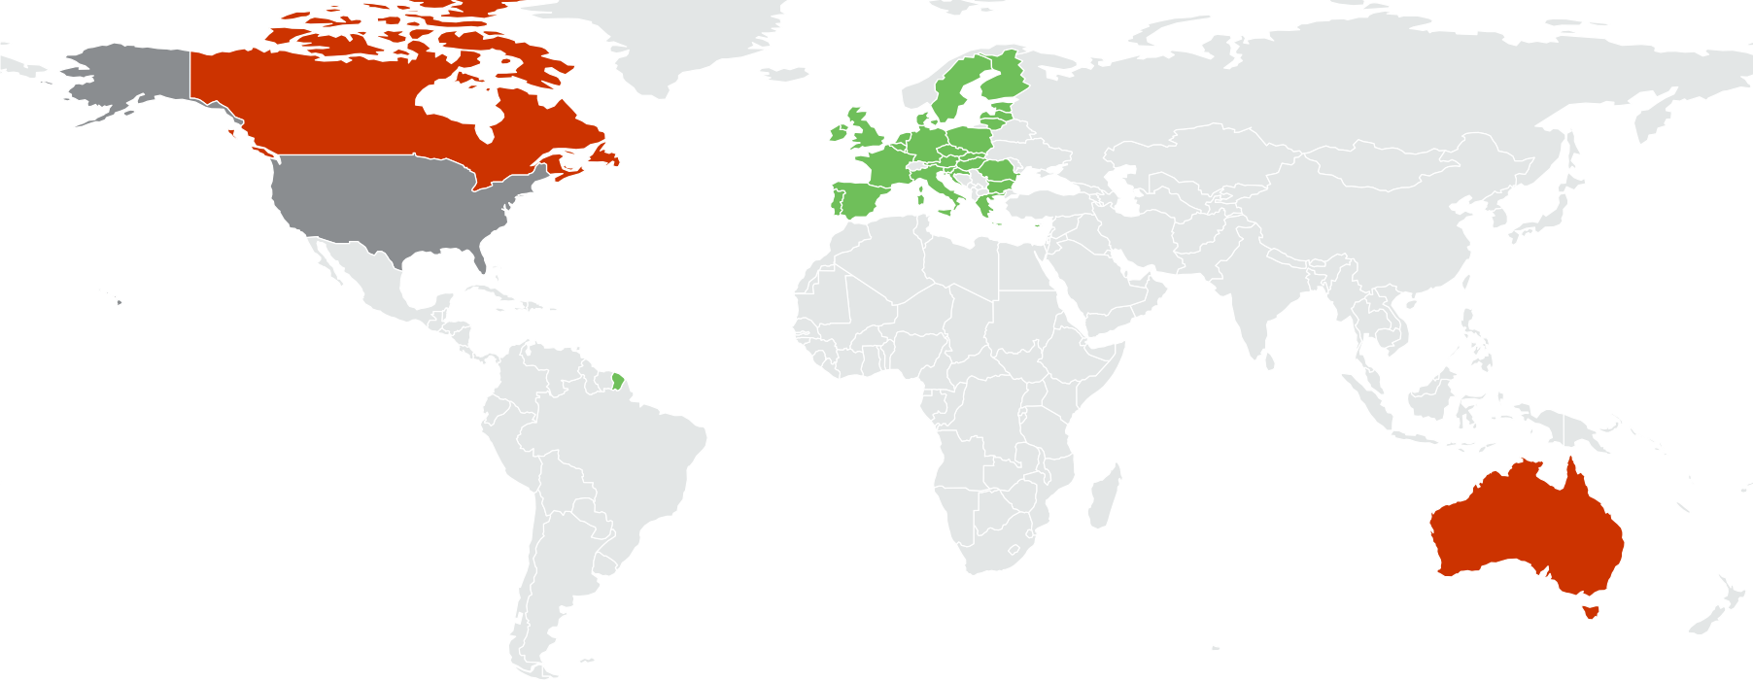



REGULATORY & MARKET CHANGE
WHERE INVESTMENT IS GOING
Fraud programs prioritize today's compliance gaps over tomorrow's regulation
Regulation remains a powerful driver of fraud spending: Nearly half (48%) are investing mainly to remediate existing compliance and control gaps, compared with 39% investing ahead of upcoming and draft regulations. How organizations split depends heavily on their size and jurisdiction.
48%
39%
13%
Remediating existing gaps
Meeting upcoming regulation
Not a driver
Fixing known compliance and control weaknesses
Building ahead of new and draft requirements
Other priorities lead
SMALLER INSTITUTIONS ARE STUCK ON REMEDIATION
REGIONAL DIFFERENCES IN INVESTMENT FOCUS
Remediation-led
Forward-looking
Evenly split
BANKING
INSURANCE
Canada
EU + UK
63% remediating
50% upcoming
Top 100 Global FIs
Top 50 Global Carriers
42% remediating · 48% upcoming
33% remediating · 47% upcoming
Large FIs
Large Carriers
United States
Singapore
54% remediating · 29% upcoming
70% remediating · 30% upcoming
41% / 43% remediating / upcoming
50% upcoming
Top 100 Global Financial Institutions are modestly weighted towards investing in upcoming regulatory requirements, whereas Large Financial Institutions are nearly twice as likely to prioritize remediation of existing gaps (54% vs. 29%).
The divergence is most pronounced in insurance, where 70% of Large Insurance Carriers prioritize investments to remediation of existing gaps, compared with 33% of Top 50 Global Insurance Carriers.
Australia
63% remediating
For detailed data please refer to Appendix – E

Slide 12






REGULATORY & MARKET CHANGE
WHATS COMING NEXT
Top of mind changes: Customer identity, AI governance, & payment innovation
Respondents were asked which upcoming regulatory or market changes will have the greatest impact on their fraud programs, respondents converged on three. Together, they point to a fraud landscape being reshaped by how customers are verified, how data and AI are governed, and how fast money moves.
TOP THREE ANTICIPATED CHANGES
71%
#1
66%
#2
65%
#3
CUSTOMER IDENTITY, AUTHENTICATION & DIGITAL TRUST
PRIVACY, DATA-SHARING & AI GOVERNANCE
PAYMENT INNOVATION
Rising expectations for how customers are verified and protected, as deepfakes and synthetic identities make it harder to know who is on the other end.
New rules on how customer data can be used and shared, and how AI models must be governed, shaping what fraud teams can build and deploy.
Real-time payments, stablecoins and agentic payments move money faster, shrinking the window to detect and stop fraud before funds are gone.
Banking 72% · Insurance 68%
Banking 68% · Insurance 60%
Banking 61% · Insurance 76%
FURTHER DOWN THE LIST
Banking 72% · Insurance 68%
#4
#5
#6
36%
33%
29%
THE TENSION: CHANGE IS COMING FASTER THAN READINESS
Liability & reimbursement changes
AML modernization initiatives
Open banking / consumer-driven banking
Respondents expect major change ahead, yet nearly half (48%) are still investing mainly to remediate existing compliance gaps.
For organizations primarily focused on remediation, especially smaller institutions, each new wave of identity, data, AI and payment requirements risks adding to the backlog rather than being addressed ahead of time.
WHY OPEN BANKING RANKS LAST
Open banking was the least selected change (29%). In many markets its frameworks are already defined and in place (e.g., the UK’s Open Banking regime, PSD2 in the EU and Australia’s Consumer Data Right), so respondents may see it as a known quantity rather than an emerging disruption.
For detailed data please refer to Appendix – E

Slide 13
Appendices

Slide 14
METHODOLOGIES
Objective
This study was conducted to understand and qualify the shift in the fraud risk landscape with the rise of agentic commerce and payments and to support and equip merchants with an understanding of the increase in AI-enabled fraud risks in agentic commerce and what needs to be considered for the implementation of effective mitigation strategies.
Data Sources
Deloitte conducted a quantitative and qualitative study incorporating a variety of data and expert insights to address a key hypothesis, incorporating data from partnering solution providers specialized in AI-enabled fraud in the retail ecosystem. This study was conducted from September to October 2025 using a combination of data sources, including:
2025 Deloitte Survey on AI-Enabled Fraud in Retail: 39 eligible responses were collected out of a total 62 responses based on the profile of the respondents, including the size of the organization and the respondent’s position
Riskified: Proprietary e-commerce transaction and fraud attempt data from global merchant network, as well as a 2025 survey of 5,000+ consumers on AI for shopping and agentic commerce risk
HUMAN Security: Proprietary digital interaction traffic and research reports across consumer digital journey from ad views, consumption, onsite, and pre/at/post login, including measurements of change in traffic patterns and digital attacks to date

Slide 15
PROFILE OF RESPONDENTS: 2025 DELOITTE SURVEY ON AI-ENABLED FRAUD IN RETAIL
To better understand industry perspectives and challenges related to agentic AI and AI-enabled fraud in retail, Deloitte surveyed 39 North American merchants across various industry verticals. All participants have relevant understanding and experiences with agentic AI, and their organizations reported annual revenues ranging from $1 million to over $100 million.
Respondent Location
Merchant Annual Revenue | # | %
Less than $1 Million | 0 | 0%
$1 Million to $49.9 Million | 2 | 5%
$50 Million to $99.9 Million | 5 | 13%
$100 Million or more | 32 | 82%
Merchant Industry Vertical | # | %
E-commerce | 15 | 38%
Hospitality | 4 | 10%
Retail | 16 | 41%
Airlines | 1 | 3%
Consumer Services | 3 | 8%
92%
8%
United States
Canada
Respondent Organizational Level | # | %
C-level or equivalent | 20 | 51%
SVP-level or equivalent | 3 | 8%
VP-level or equivalent | 7 | 18%
Director-level or equivalent | 7 | 18%
Senior Manager-level or equivalent | 2 | 5%

Slide 16
RESULTS OF 2025 DELOITTE SURVEY ON AI-ENABLED FRAUD IN RETAIL
Types of AI-enabled fraud experienced in the past year
Fake/synthetic identity
Document fabrications
Deepfake impersonations
Phishing/spear phishing
Social engineering
Brute force password attacks
Account takeovers
Man-in-the-middle attacks
Fake websites/storefronts
Fraudulent transactions/credit cards
Coupon/promotion abuse
Returns/damage fraud
Areas seen as particularly vulnerable to AI-enabled fraud
Expected increase in volume of agentic AI-enabled attacks in the next 12 months
Automated phishing | 82%
Synthetic Identity Creation | 69%
Deepfake social engineering | 69%
Payment/card fraud | 62%
Refund/chargeback abuse | 41%
Loyalty program/rewards | 36%
Order manipulation | 23%
Price manipulation | 15%
Internal fraud | 15%
Other | 5%
69%
of merchants experienced fraud enabled by AI in past year
95%
of merchants are planning to adapt their fraud strategy for agentic AI
Top barriers to implementing effective mitigation strategies against AI-enabled fraud

Slide 17
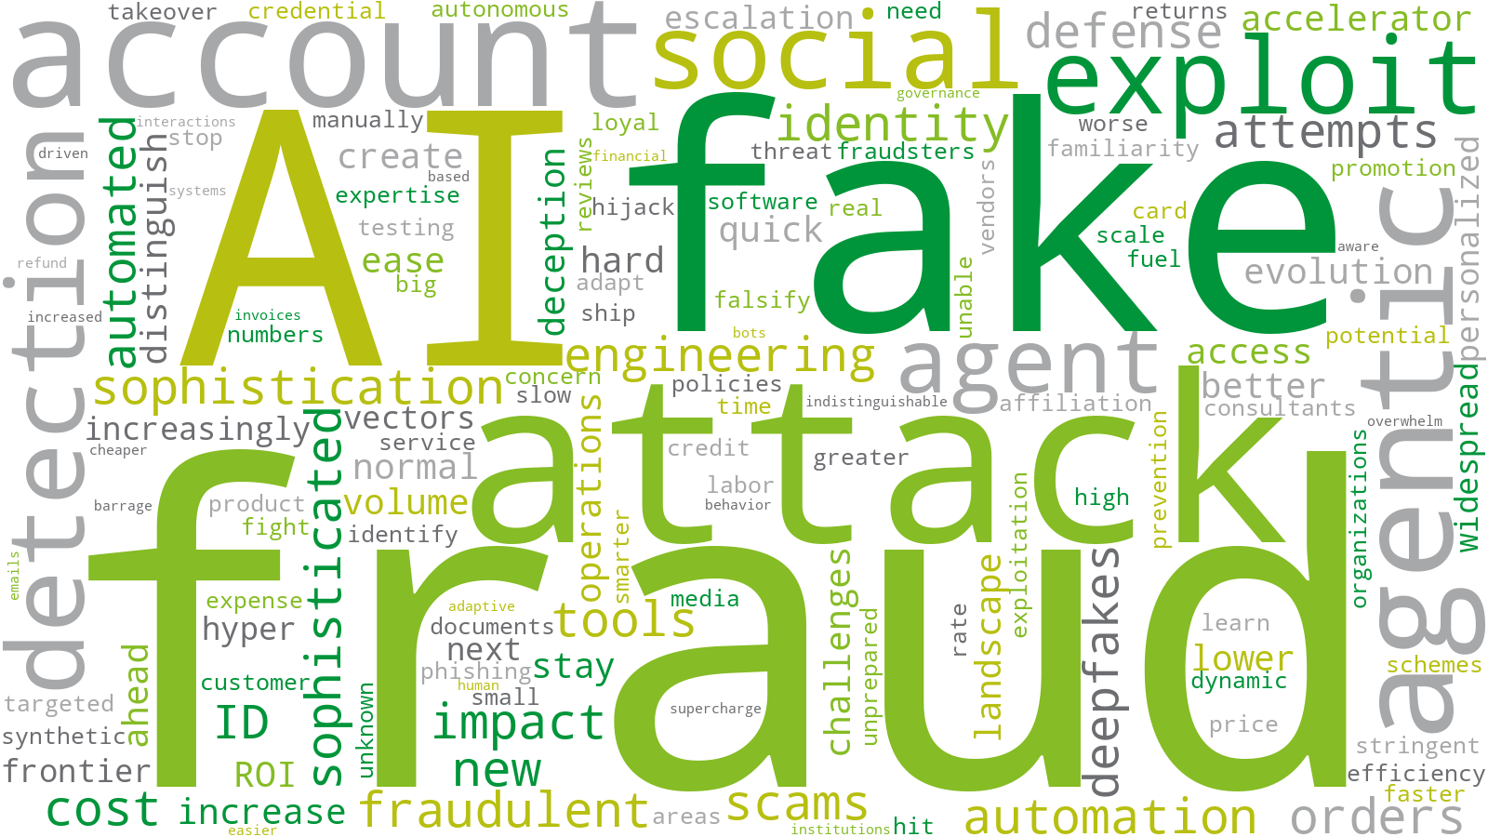
RESULTS OF 2025 DELOITTE SURVEY ON AI-ENABLED FRAUD IN RETAIL (CONT’D.)
Respondents consistently emphasized keywords such as AI, fraud, automation, and agentic capabilities – signaling the areas expected to define the retail fraud landscape over the next 2-3 years.
The top emerging themes included:
“Greater difficulty distinguishing fraud from legitimate retail activity”
“Escalating sophistication and volume of retail fraud attacks”
“Expansion of scalable, low-cost AI-enabled fraud schemes”
“Rapid evolution of fraud tactics through agentic AI and automation”

Slide 18
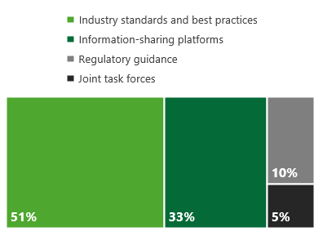
RESULTS OF 2025 DELOITTE SURVEY ON AI-ENABLED FRAUD IN RETAIL (CONT’D.)
If replied ‘Yes’ to updating fraud strategy or implementing new controls, what have they worked on?
Know Your Agent and risk models
Penetration testing
Multilevel authentication
Adoption of industry best-practices
Development of internal tool/procedures
Controls focusing on AI for internal audit programs
AI detection tools (e.g., adaptive AI, behavioral analytics, real-time threat orchestration)
Inclusion of data use for AI in contracting language
Reduction of human involvement for making fraud decisions
Fortification of email and mobile security
Merchant preparedness to handle AI-enabled fraud for the future
Organizations that have updated their fraud strategy or implemented new controls to manage fraud enabled by AI
67% Yes
33% No
Mitigation strategies expected to be most effective against AI-enabled fraud
Industry-wide measures seen as most-needed to address AI-enabled fraud
Merchants currently using or considering using agentic AI in customer-facing channels

